Slide 1
GOLANG BASIC
2024, 23 February

Slide 2
Outline
Install
Declarations
Variable
Constanta
Data Types
Input & Output
Print Output
Take Input
Conversion & Assertion
Type Conversion
Type Assertion
Comments
Flow Control
Operators
Conditional Statements
Loop Statements
Collection Types
Array
Slice
Map
Empty Type
Function
Parameter
Return Value
Return Predefined Value
Variadic
Access Modifier
Public Property
Private Property
Declaration Types
Struct
Interface
Method
Pointer
Defer, Error, Panic, Recover

Slide 3
FLOW CONTROL

Slide 4

Flow Control
The control flow is the order in which the computer executes statements in a script.
Code is run in order from the first line in the file to the last line, unless the computer runs across the structures that change the control flow, such as conditionals and loops.
Notes:
https://developer.mozilla.org/en-US/docs/Glossary/Control_flow

Slide 5
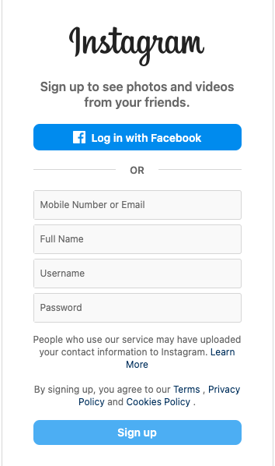
Example Flow Control
Imagine a script used to validate user data from a webpage form.
The script submits validated data, but if the user, say, leaves a required field empty, the script prompts them to fill it in.
To do this, the script uses a conditional structure or if … else, so that different code executes depending on whether the form is complete or not.
Notes:
https://developer.mozilla.org/en-US/docs/Glossary/Control_flow

Slide 6
Flow Control
Operators
Conditional Statements
Loop Statements

Slide 7
Operators
Arithmetic Operators
Logical Operators
Comparison Operators

Slide 8
Arithmetic Operators
Operator | Description
+ | Addition
- | Subtraction
* | Multiplication
/ | Division
% | Modulus

Slide 9
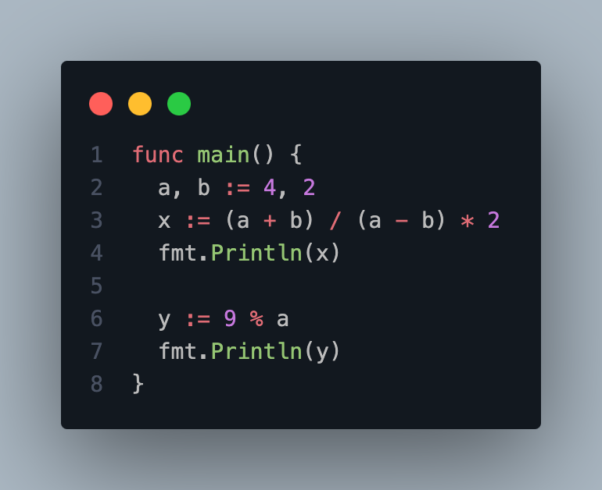
Arithmetic Operators

Slide 10
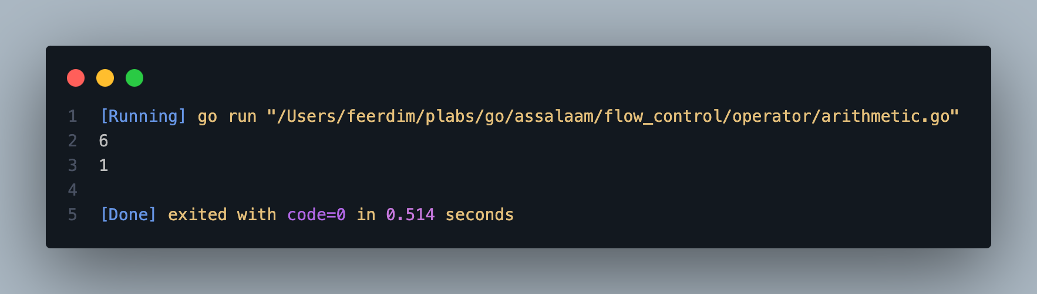
Arithmetic Operators

Slide 11
Augmented Assignments
Operator | Augmented Assignments
a = a + 10 | a += 10
a = a - 10 | a -= 10
a = a * 10 | a *= 10
a = a / 10 | a /= 10
a = a % 10 | a %= 10

Slide 12
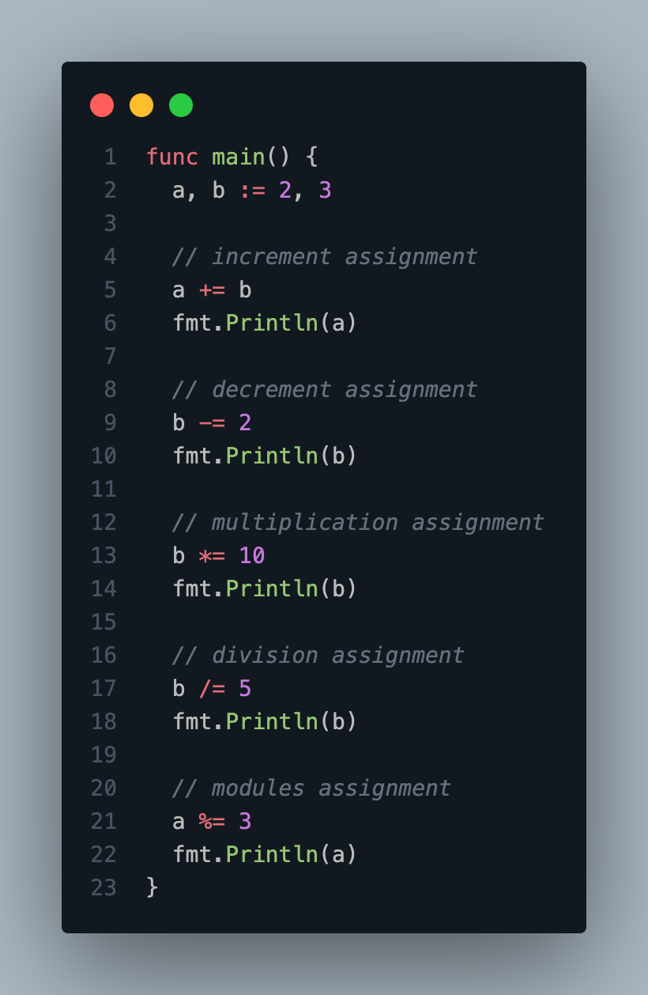
Augmented Assignments

Slide 13
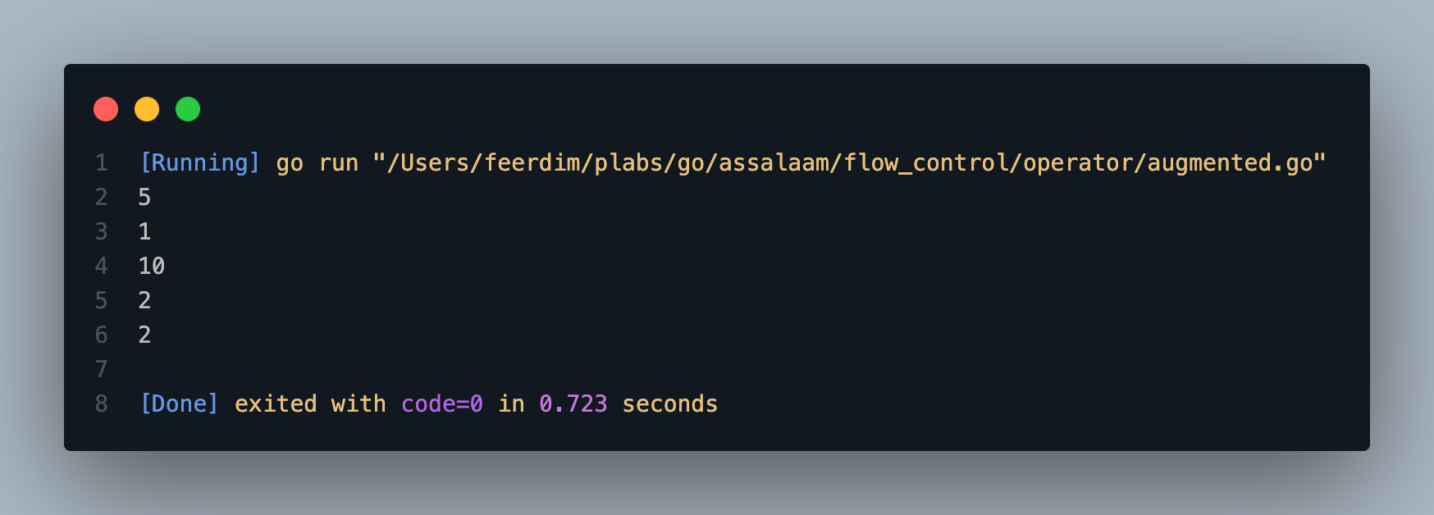
Augmented Assignments

Slide 14
Unary Operators
Operator | Description
++ | Increment
-- | Decrement
- | Negative
+ | Positive

Slide 15
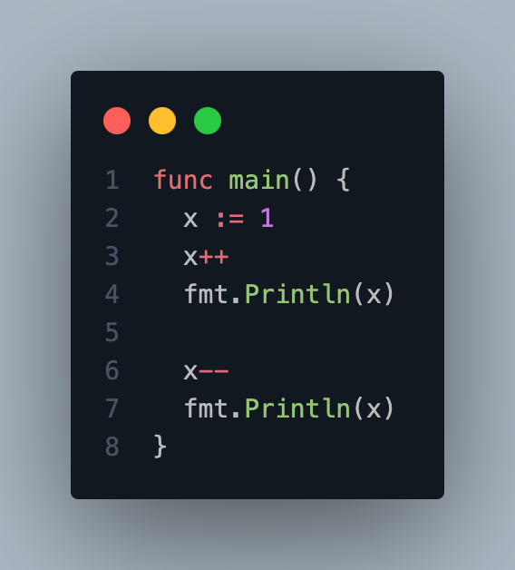
Unary Operators

Slide 16
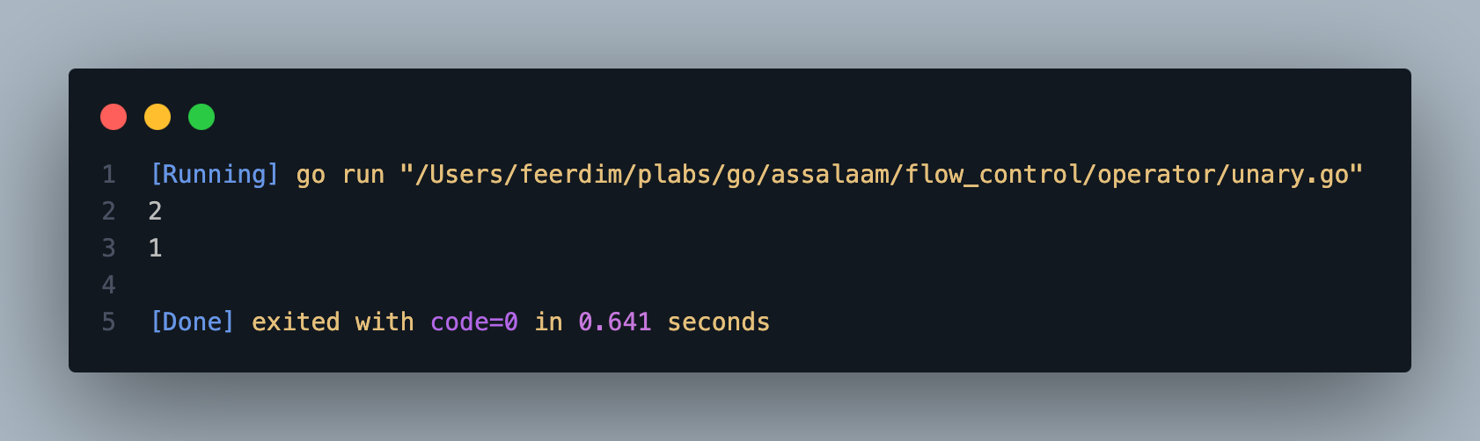
Unary Operators

Slide 17
Comparison Operators
Operator | Description
== | Equal
!= | Not equal
< | Less
<= | Less or equal
> | Greater
>= | Greater or equal

Slide 18
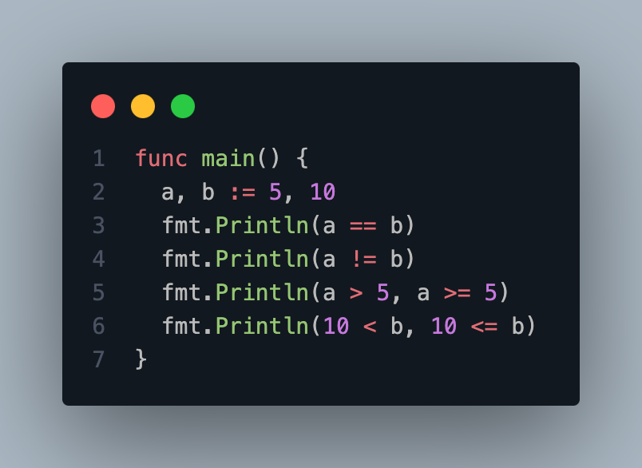
Comparison Operators

Slide 19
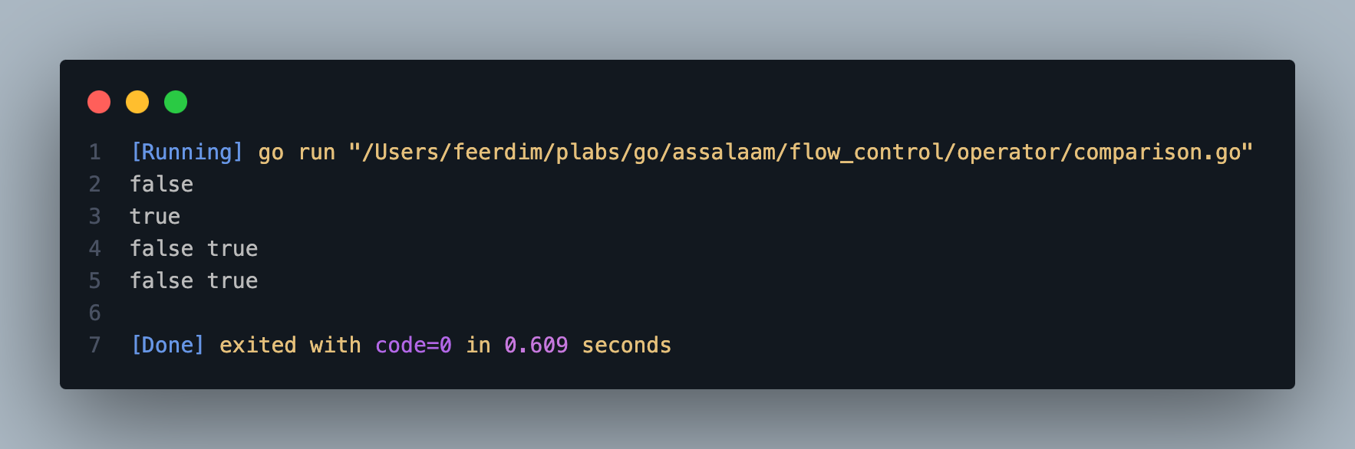
Comparison Operators

Slide 20
Logical Operators
Operator | Description
&& | Conditional AND
|| | Conditional OR
! | Not or Negation

Slide 21
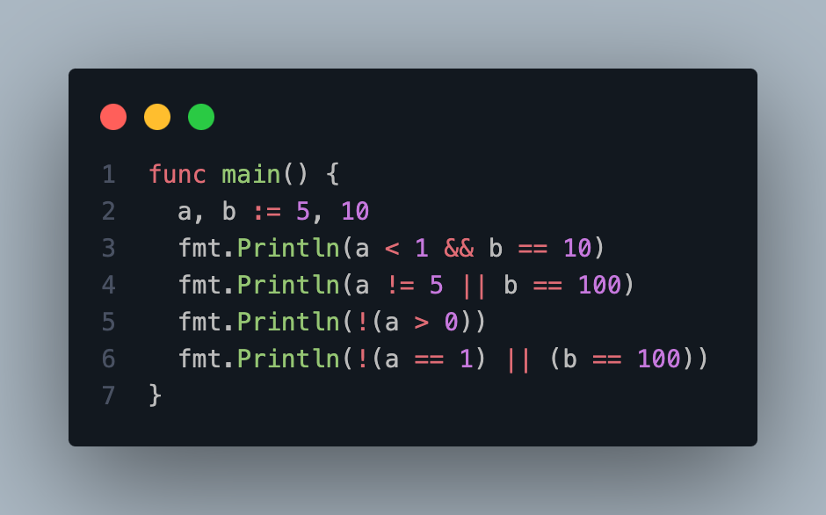
Logical Operators

Slide 22
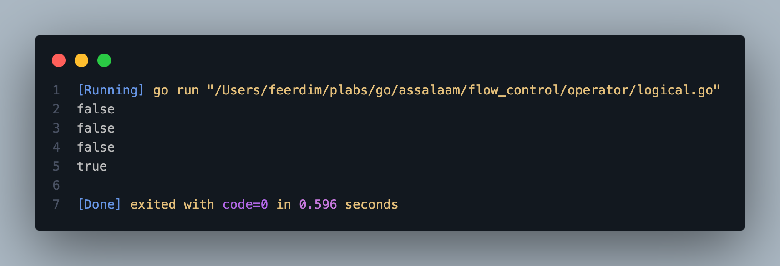
Logical Operators

Slide 23
Conditional Statements
If Expression
Switch Expression

Slide 24
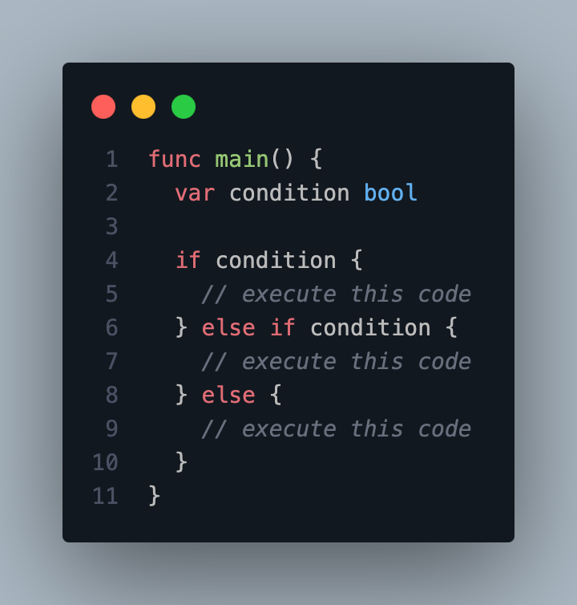
If Expression
If
Else if
Else

Slide 25
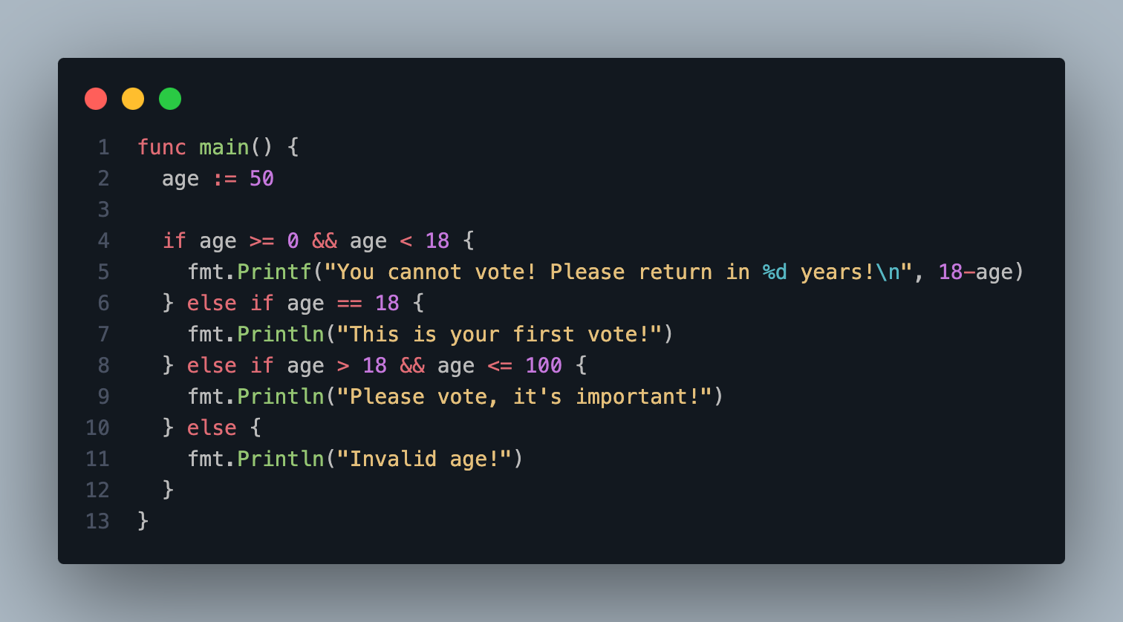
If Expression

Slide 26
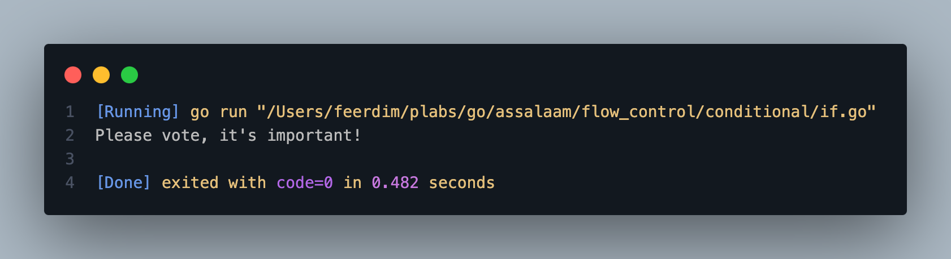
If Expression

Slide 27
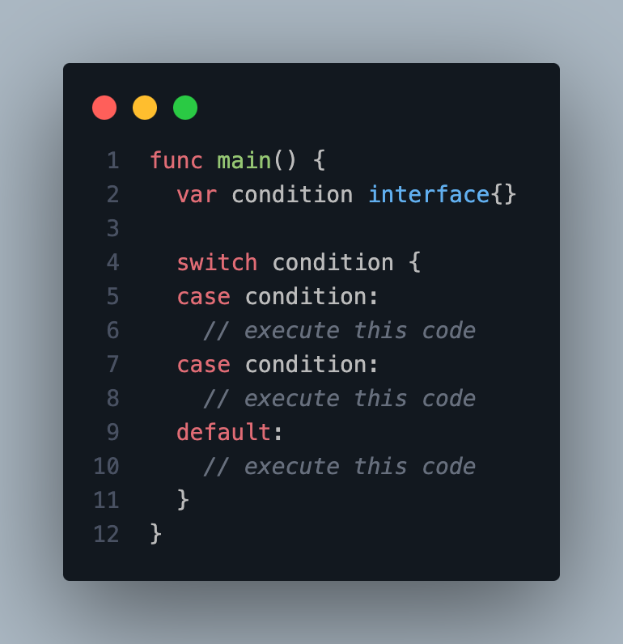
Switch Expression
Switch
Case
Default

Slide 28
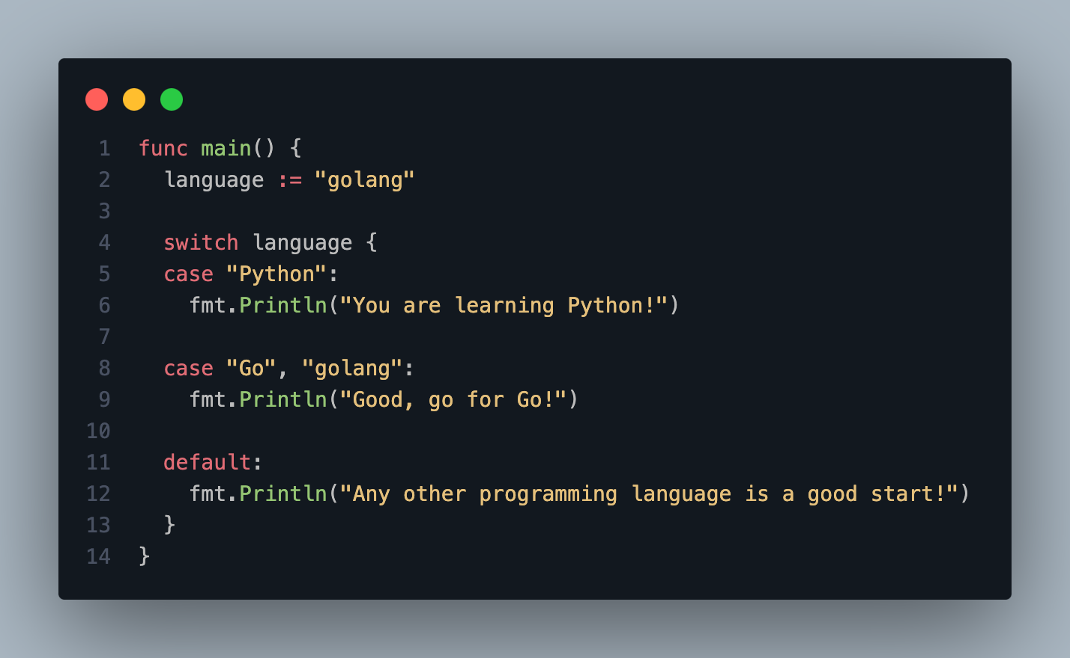
Switch Expression

Slide 29
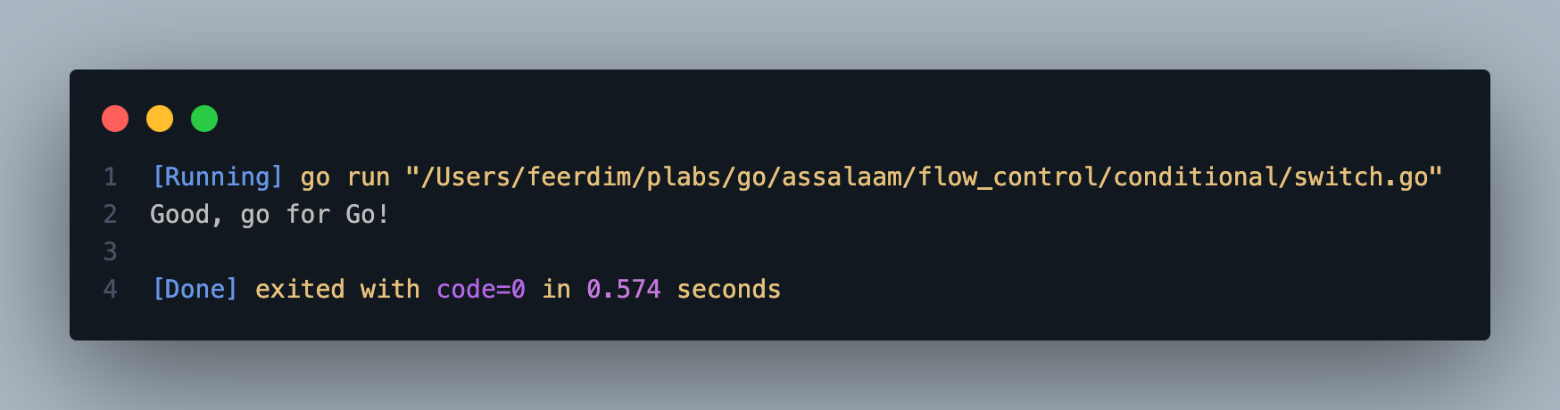
Switch Expression

Slide 30
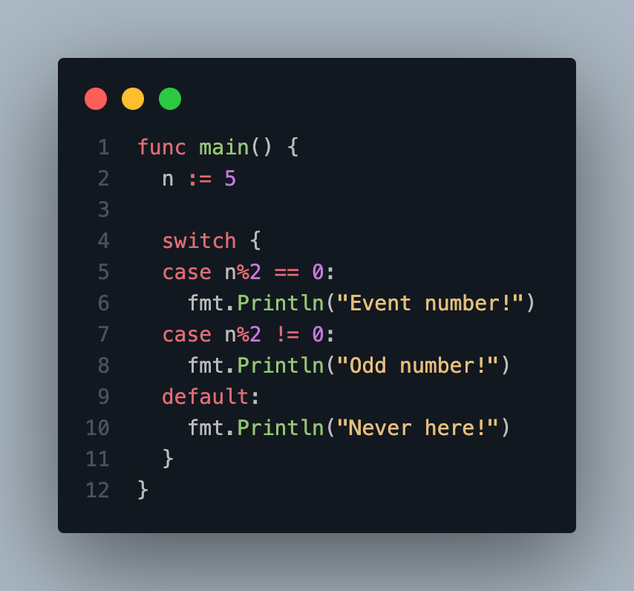
Switch Expression

Slide 31
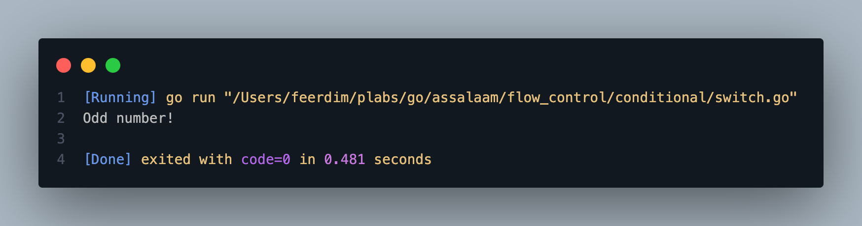
Switch Expression

Slide 32
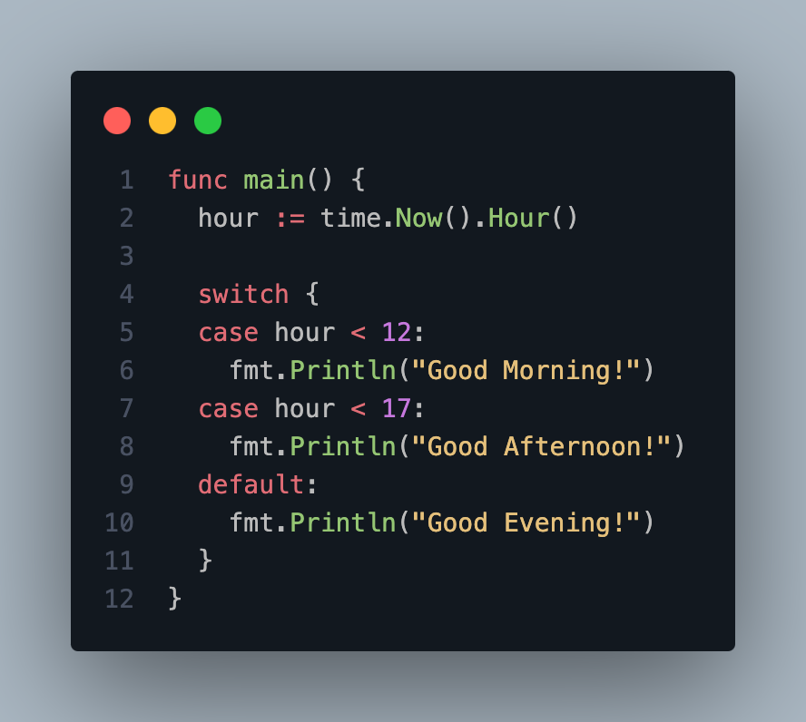
Switch Expression

Slide 33

Switch Expression

Slide 34
Loop Statements
For Expression

Slide 35
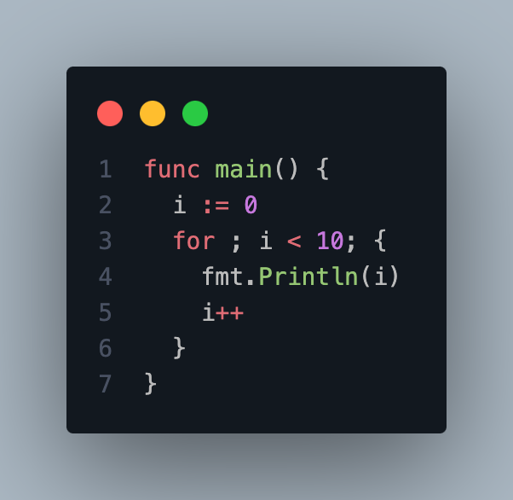
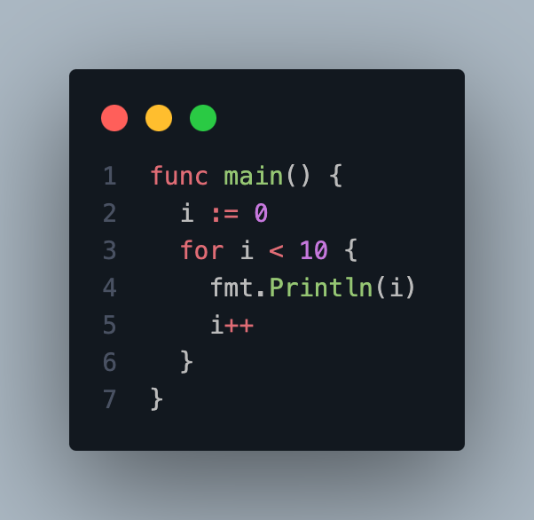
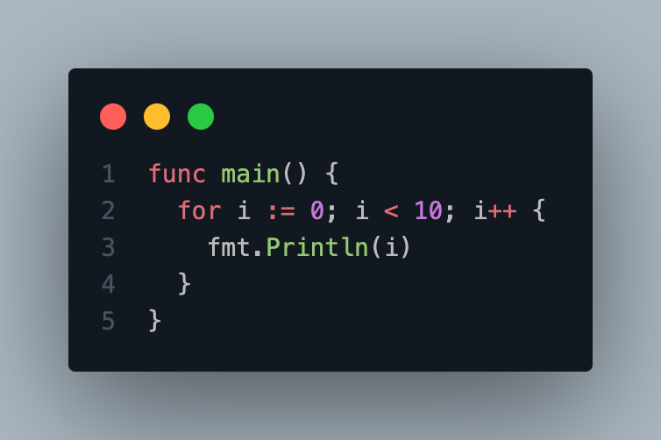
For Expression

Slide 36
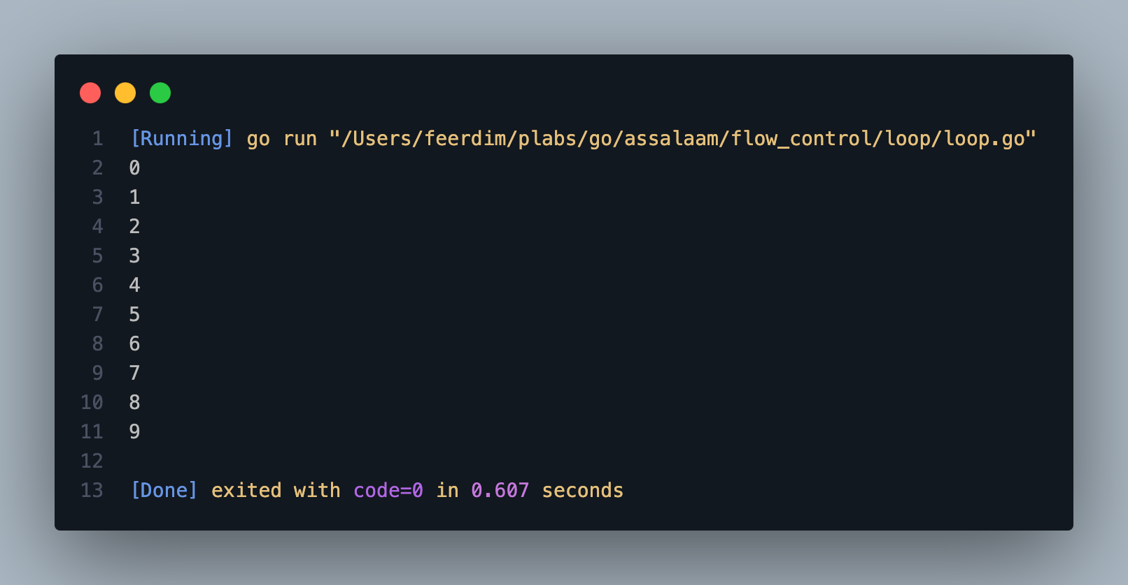
For Expression

Slide 37
For Expression
Break
Continue
Range

Slide 38
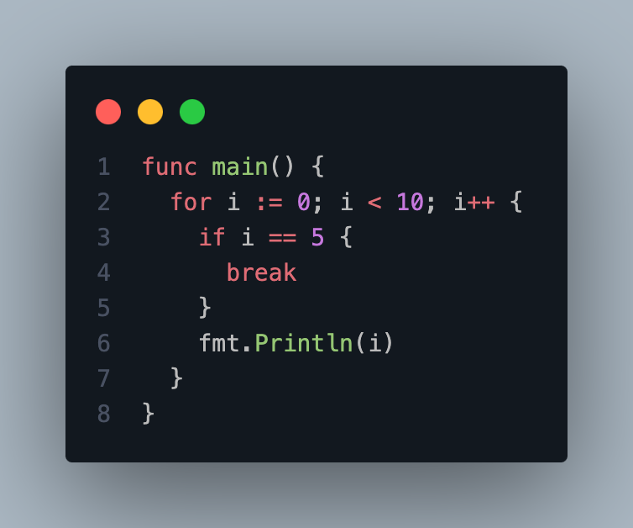
For with Break Expression

Slide 39
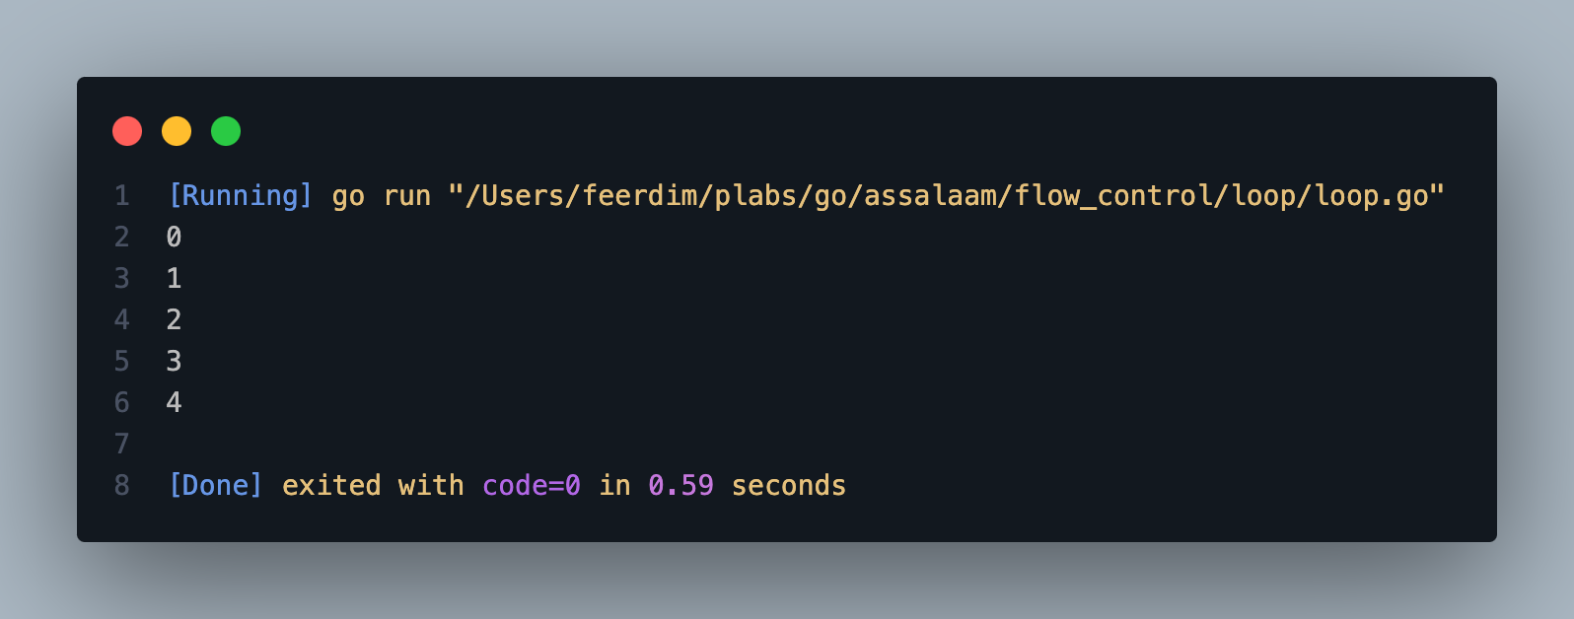
For with Break Expression

Slide 40
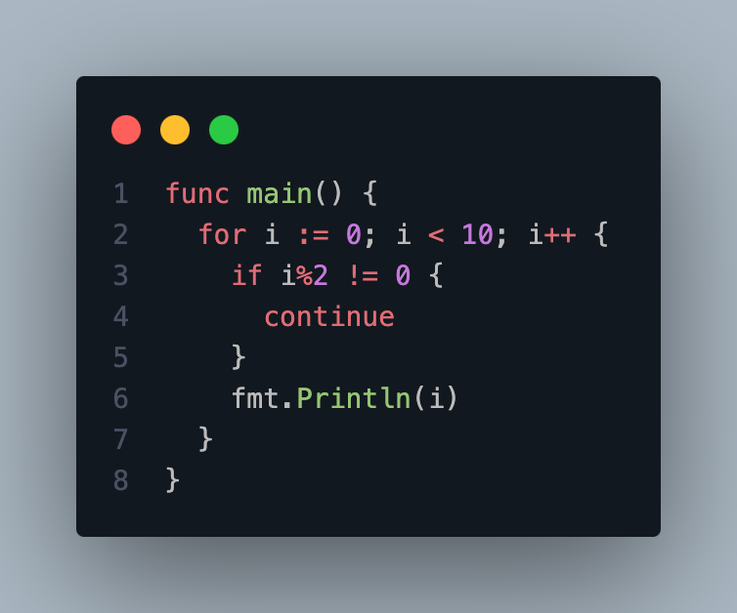
For with Continue Expression

Slide 41
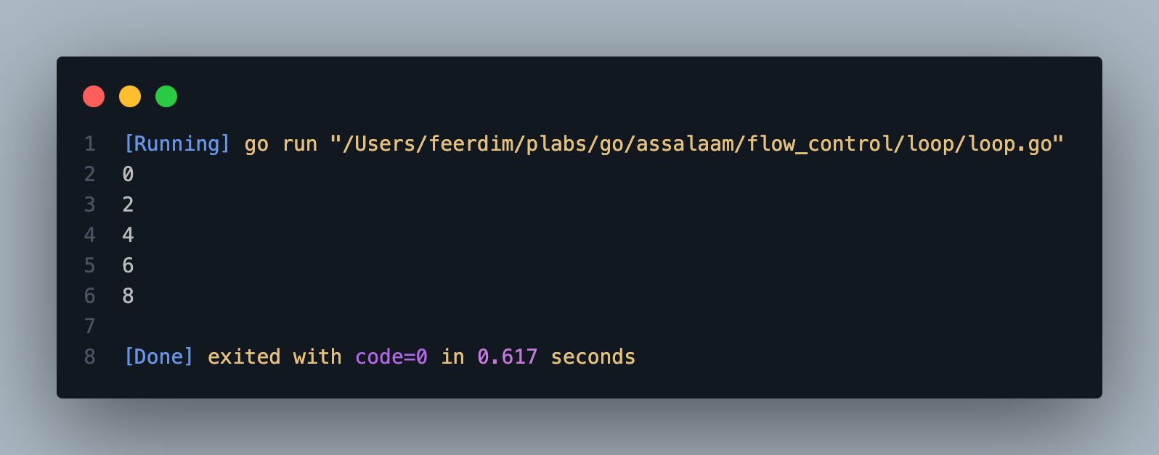
For with Continue Expression

Slide 42
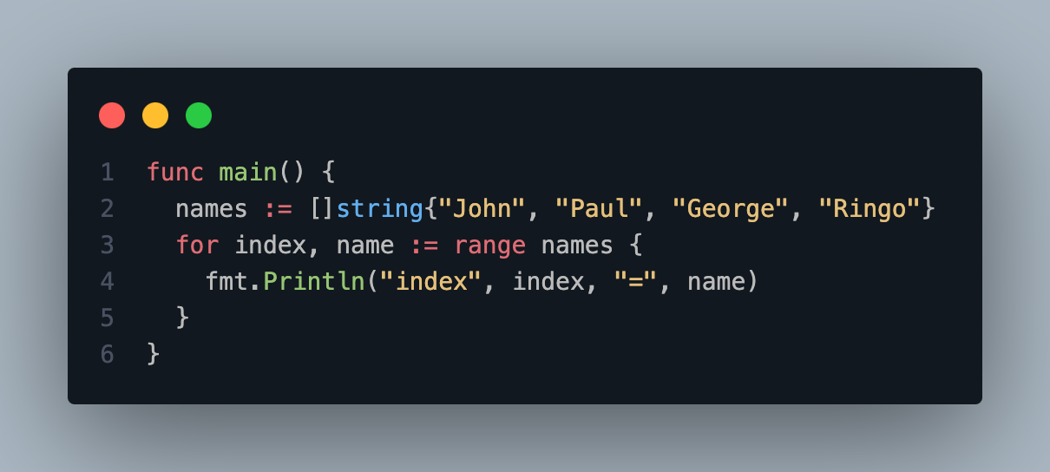
For with Range Expression

Slide 43
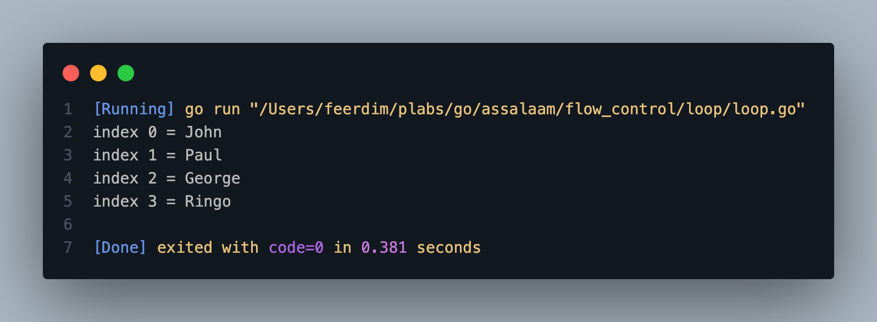
For with Range Expression

Slide 44
COLLECTION TYPES

Slide 45

Collection Types
Array
Slice
Map

Slide 46
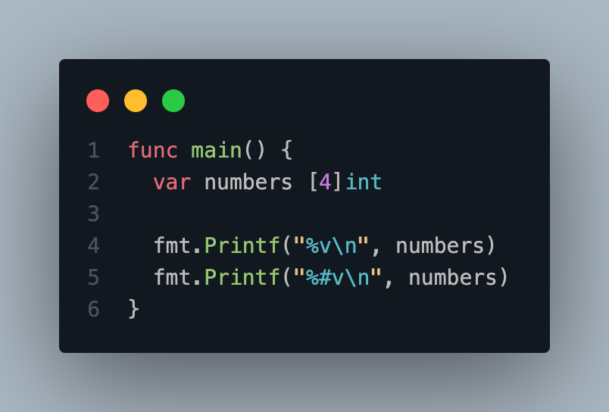
Array
An array is a data type that contains a collection of data of the same type.
When creating an array, we need to specify the amount of data that the array can hold.
The amount of data the array can hold cannot change after the array is created.

Slide 47
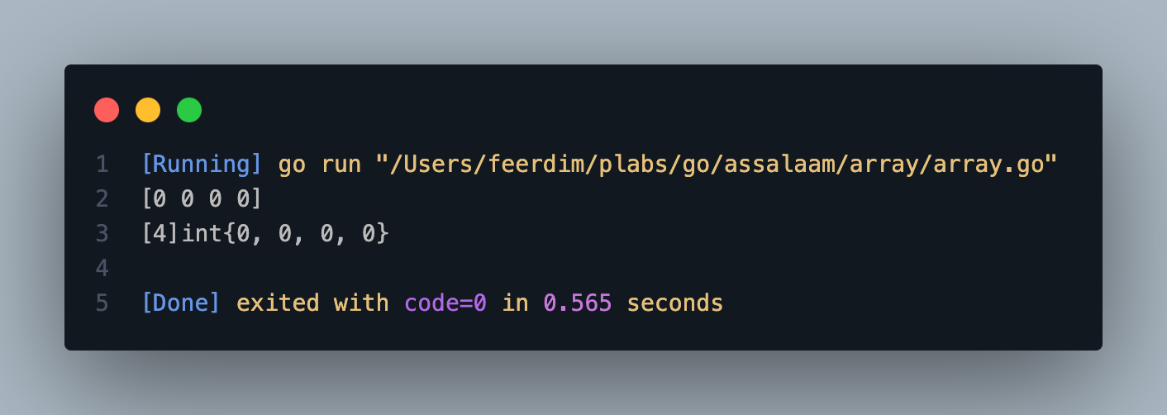
Array

Slide 48
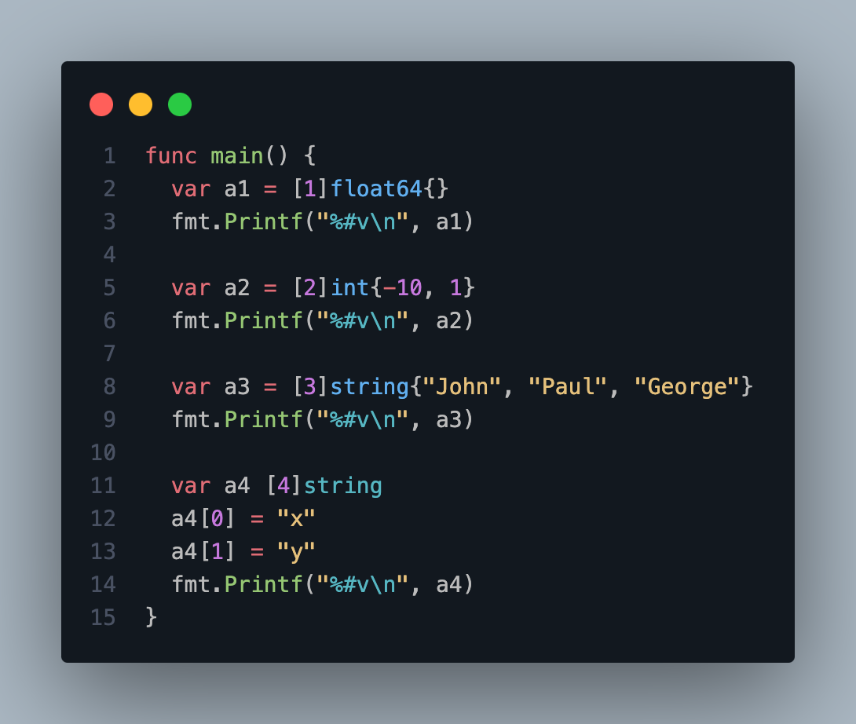
Array
Notes:
Array literal

Slide 49
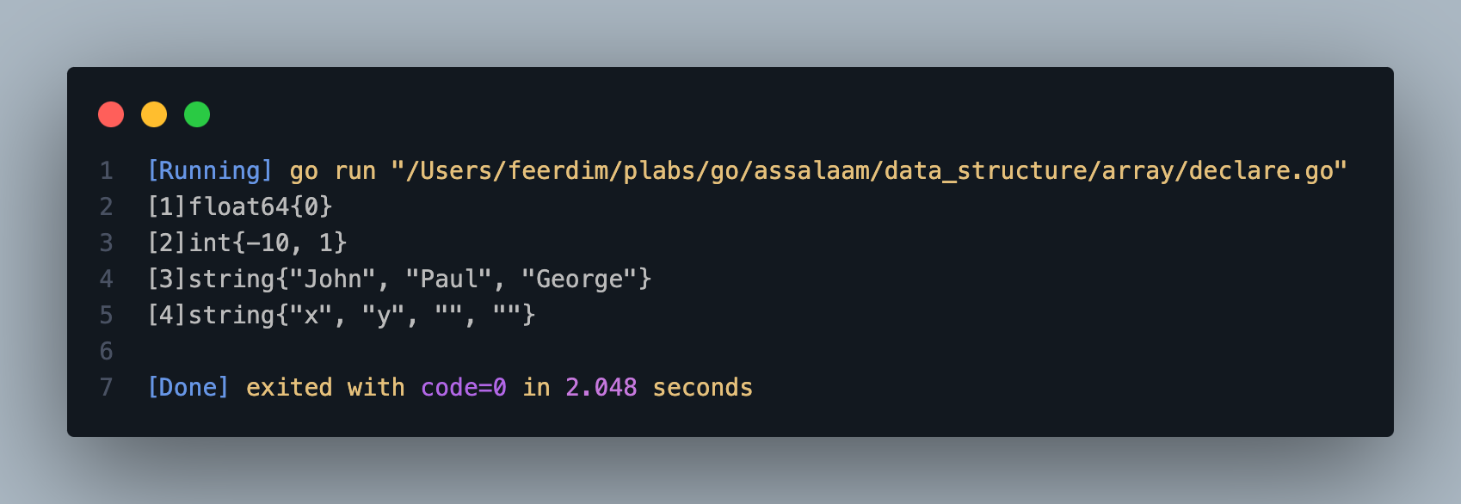
Array

Slide 50
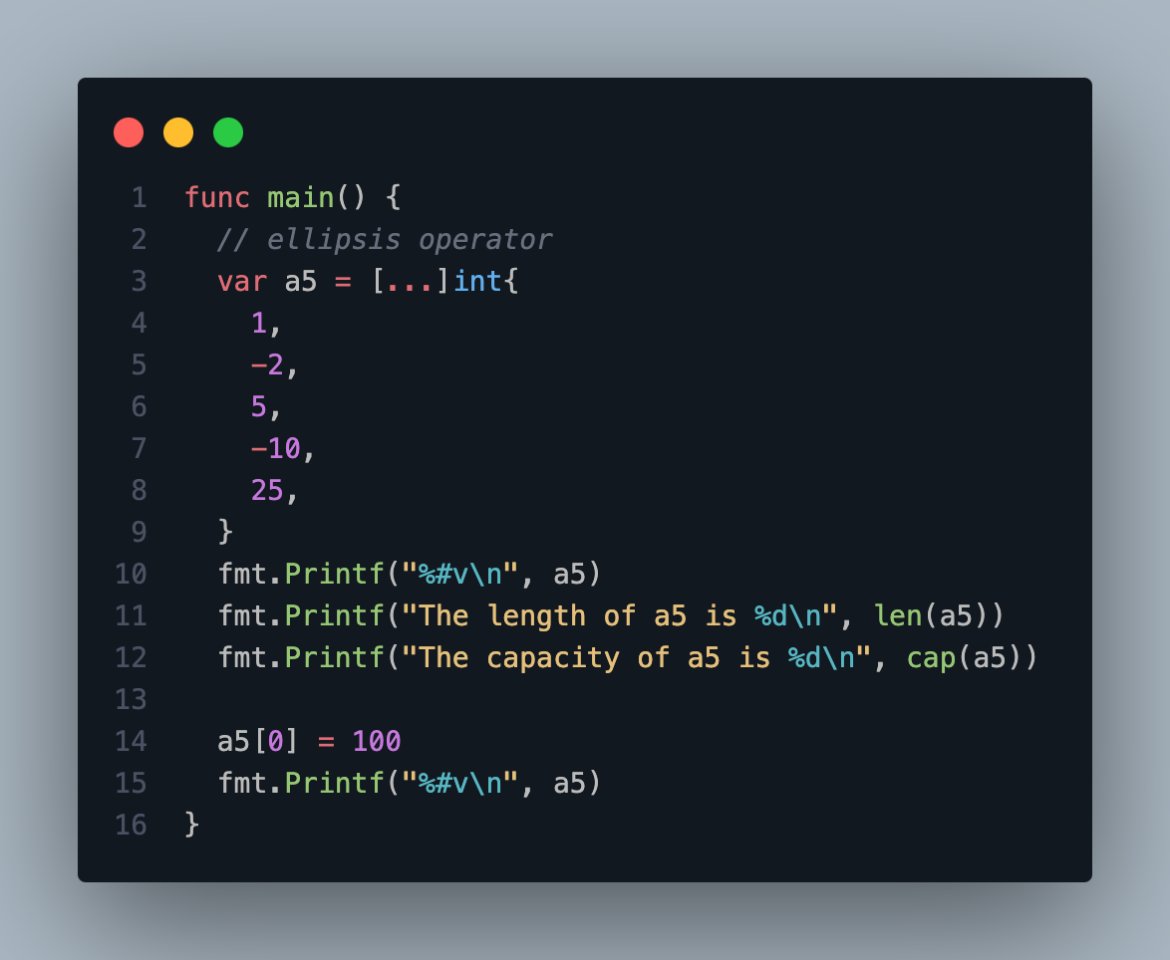
Array
Array has 2 data :
Length
Capacity

Slide 51
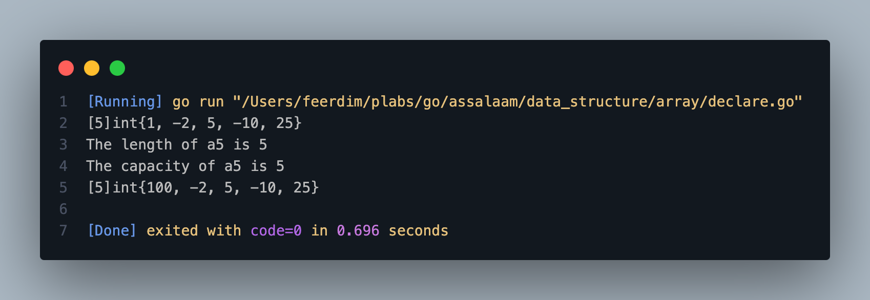
Array

Slide 52
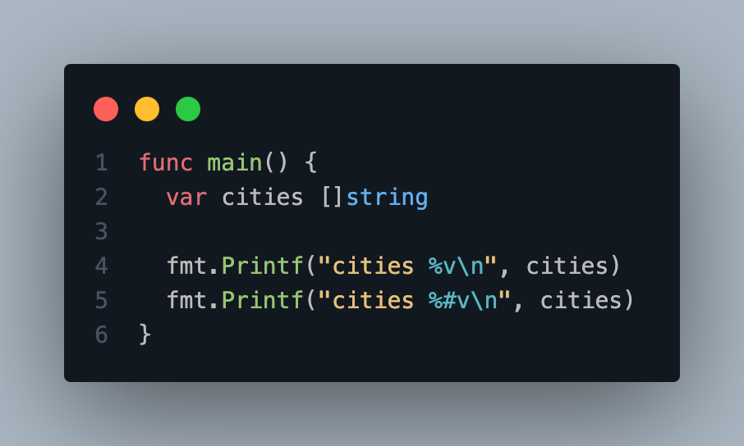
Slice
Slice is a data type that is like an array, as it is a slice of an array.
The difference is the capacity size that can change.

Slide 53
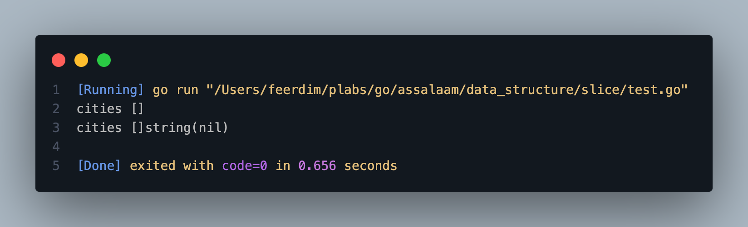
Slice

Slide 54
Slice
Slice has 3 data
Pointer
Length
Capacity

Slide 55
Slice
Make Slice | Description
array[low:high] | Make a slice of the array from index low to index before high
array[low:] | Make a slice of the array from index low to last index in the array
array[:high] | Make a slice of the array from index 0 to index before high
array[:] | Make a slice of the array from index 0 to last index in the array

Slide 56
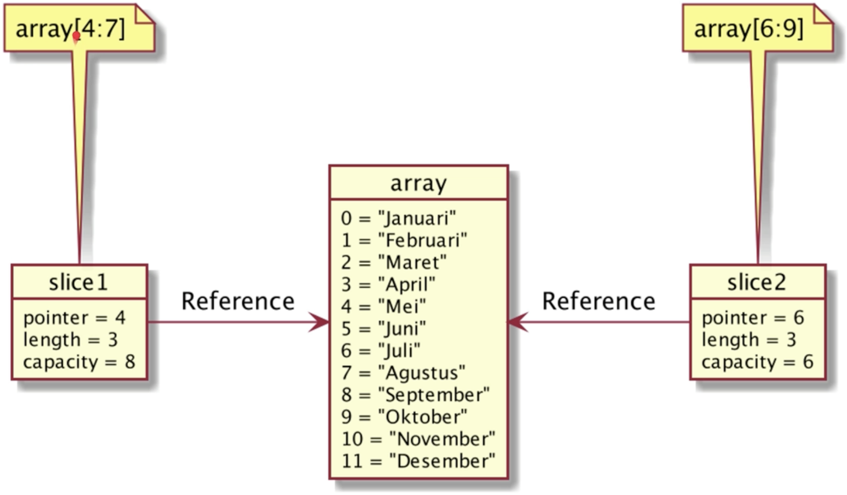
Slice

Slide 57
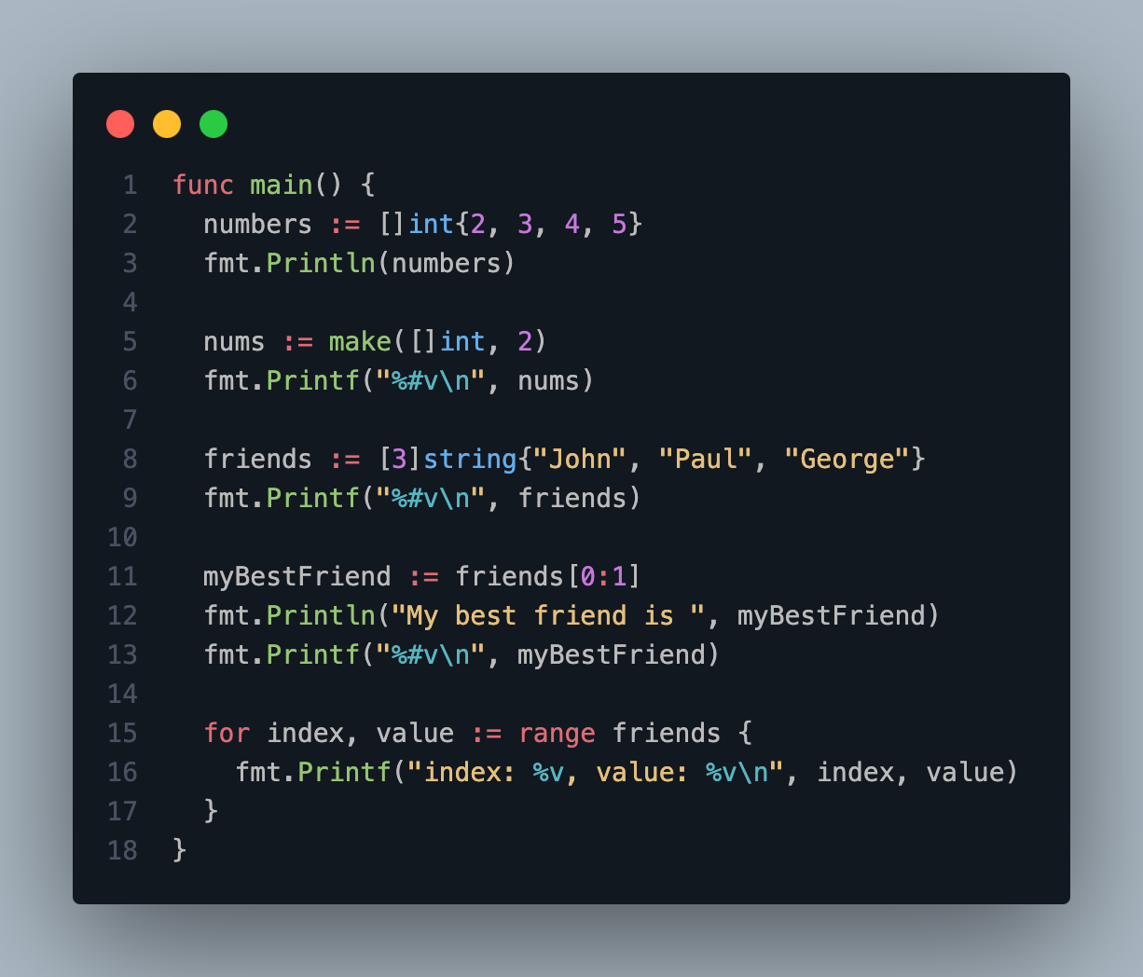
Slice

Slide 58
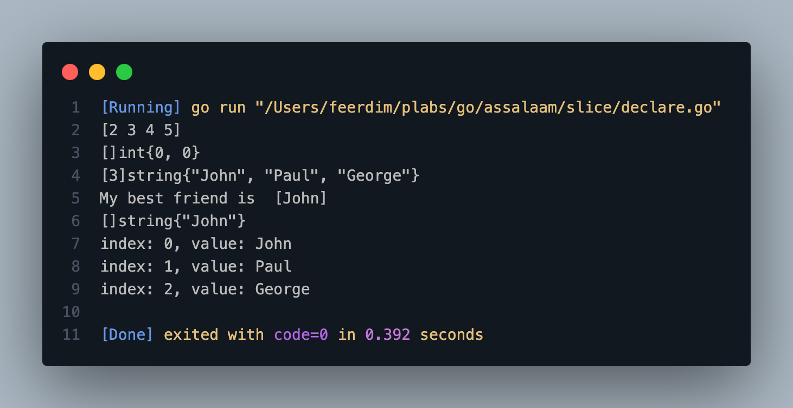
Slice

Slide 59
Function Slice
Function Slice | Description
len(slice) | Get the length of the slice
cap(slice) | Get the capacity of the slice
append(slice, data) | Create a new slice by adding data to the last index of the slice (If the capacity is full, it will create an array with 2 times the capacity)
make([]DataType, length, capacity) | Create a new slice
copy(destination, source) | Copy the slice from source to destination

Slide 60
Array vs Slice
Array
Slice
Has a fixed length defined at compile time
The length of an array is part of its type, defined at compile time and cannot be changed
By default, an uninitialized array has all elements equal to zero
Has a dynamic length (it can shrink or grow)
The length of a slice is not part of its type, and it belongs to runtime
An uninitialized slice is equal to nil (its zero value is nil)

Slide 61
Map
In Array dan Slice, to access the data, we use the Number index that starts from 0.
Map is another data type that contains the same set of data, but we can specify the type of index data type that we will use.
Simply put Map is a key-value collection data type, where the keywords are unique and cannot be the same.
Unlike Array and Slice, the amount of data we put into Map can be as much as possible, as long as the keywords are different.
If we use the same keyword, then the previous value will automatically be replaced with the new value.
{
key1: value1,
key2: value2,
key3: value3,
}

Slide 62
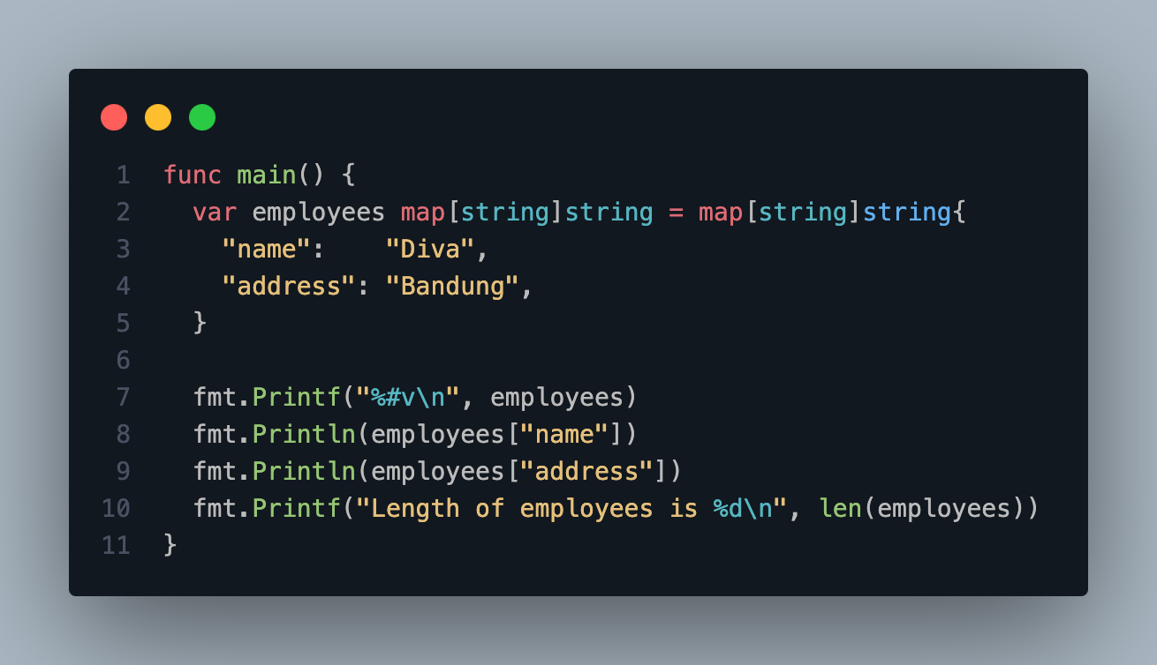
Map

Slide 63
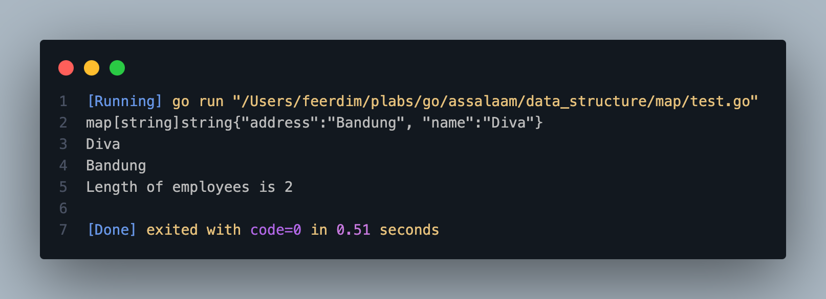
Map

Slide 64
Function Map
Function Map | Description
len(map) | Get the length of the map
make(map[TypeKey]TypeValue) | Create a new map
delete(map, key) | Delete data of key from the map

Slide 65
EMPTY TYPE

Slide 66
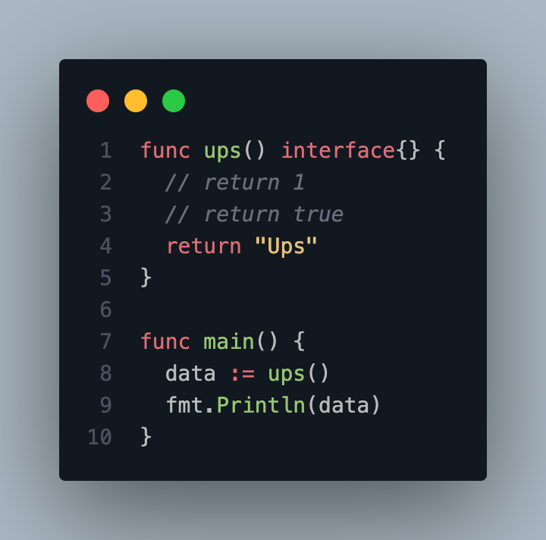
Empty Interface

Slide 67
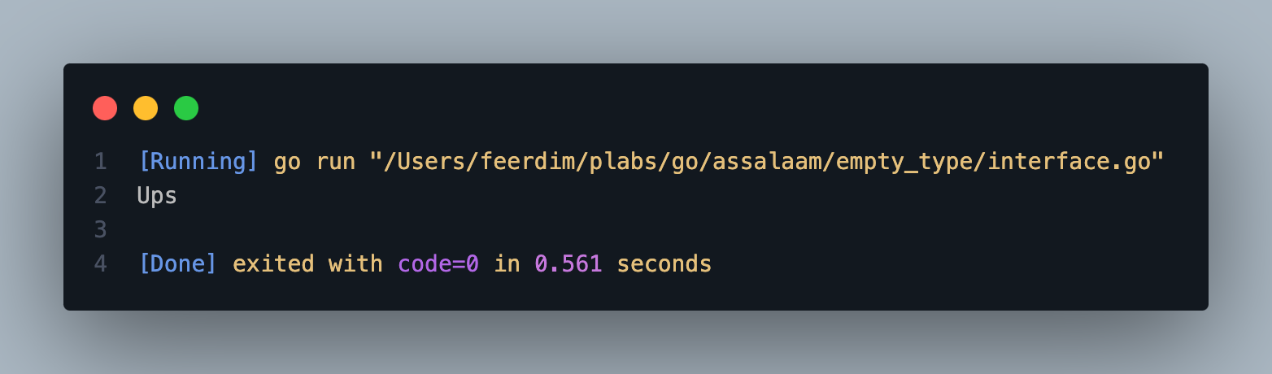
Empty Interface

Slide 68
FUNCTIONS

Slide 69
Functions
Parameter
Return Value
Return Predefined Value

Slide 70
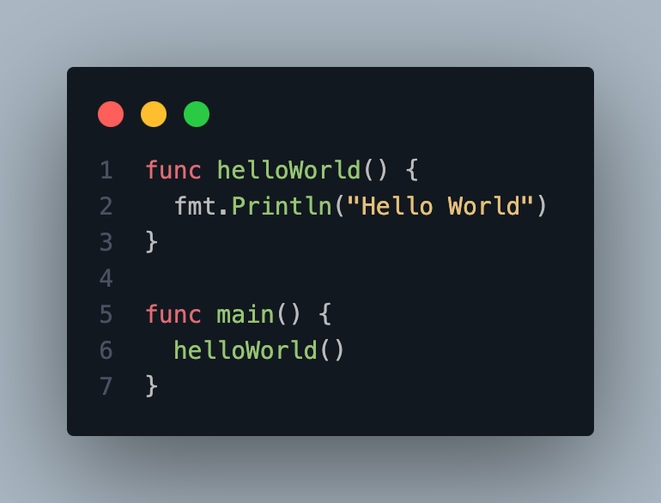
Functions

Slide 71
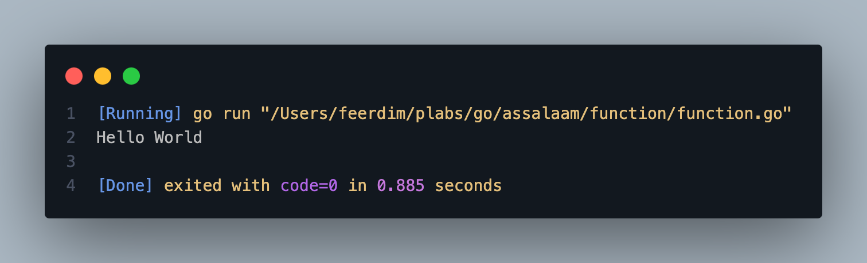
Functions

Slide 72
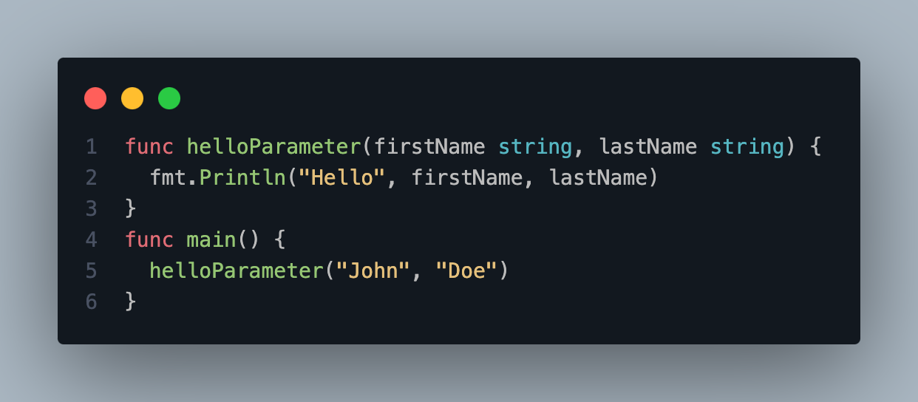
Function Parameter

Slide 73
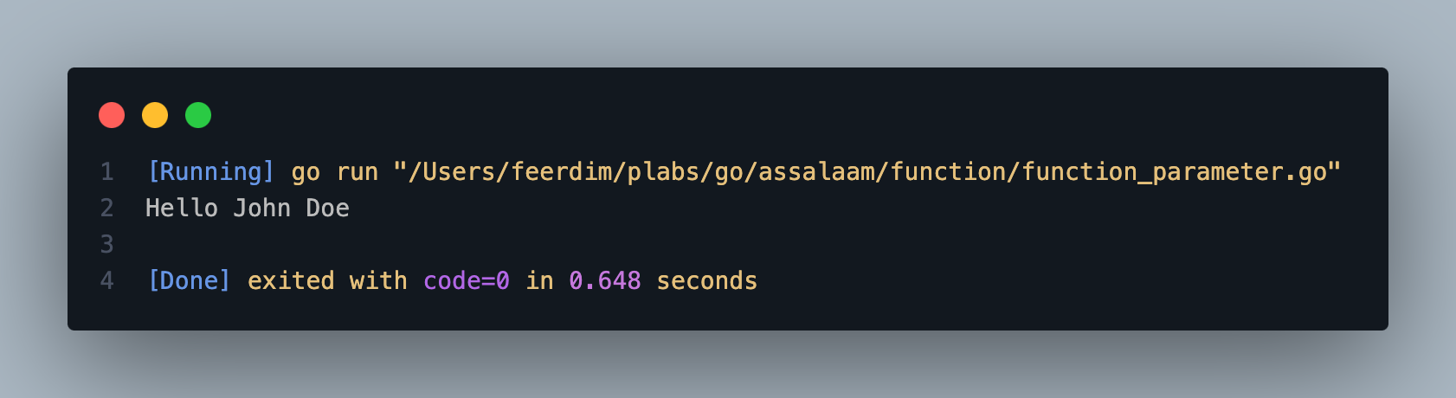
Function Parameter

Slide 74
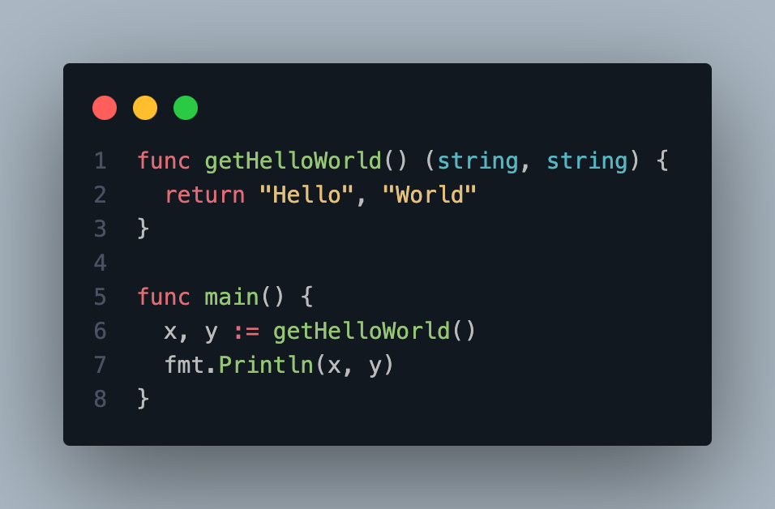
Function Return Value

Slide 75

Function Return Value

Slide 76

Function Predefined Value

Slide 77

Function Predefined Value

Slide 78

Variadic Function

Slide 79

Variadic Function

Slide 80
ACCESS MODIFIER

Slide 81
Access Modifier
Public Property
Private Property

Slide 82


Access Modifier

Slide 83

Access Modifier

Slide 84
DECLARATION TYPES

Slide 85
Declaration Types
Struct
Interface

Slide 86

Struct
Notes:
Sebuah template data yang digunakan untuk menggabungkan nol atau lebih tipe data lainnya dalam satu kesatuan.
Struct adalah kumpulan field.

Slide 87

Struct

Slide 88
Interface
Interface adalah tipe data Abstract, dia tidak memiliki implementasi langsung.
Sebuah interface berisikan definisi-definisi method.
Biasanya interface digunakan sebagai kontrak.

Slide 89
METHOD

Slide 90

Method

Slide 91

Method

Slide 92
POINTER

Slide 93

Pointer
Notes:
Secara default, di Golang semua variable itu di passing by value, bukan by reference.
Artinya jika kita mengirim sebuah vairbale ke dalam func, method, atau variable lain.
Sebenernya yang dikirm adalah duplikasi valuenya.

Slide 94

Pointer

Slide 95

Pointer
Notes:
Pointer adalah kemampuan untuk membuat reference ke lokasi data di memory yang sama, tanpa menduplikasi data yang sudah ada.
Sederhananya dengan kemampuan pointer, kita bisa membuat pass by reference.

Slide 96
Operator Pointer
Ampersand (&)
Asterisk (*)
Notes:
Untuk membuat sebuah variable dengan nilai pointer ke variable yang lain, kita bisa menggunakan operator & diikuti dengan nama variablenya

Slide 97

Pointer Operator Ampersand (&)

Slide 98

Pointer Operator Ampersand (&)

Slide 99

Pointer Operator Asterisk (*)

Slide 100
DEFER, ERROR, PANIC, RECOVER

Slide 101

Defer

Slide 102

Defer

Slide 103

Error & Panic

Slide 104

Error & Panic

Slide 105

Recover

Slide 106

Recover

